Slide 1
Diyala University / College of Education for Humanities
Asst.Inst. Eman Ahmed Hasson
Methods of Teaching English
Second Grade
The eighth Lecture
Roles the teacher can play to promote
Interaction in the classroom

Slide 2
Roles the teacher can play to promote interaction in the classroom
01
1-Engeneer the amount of classroom talk we do.
2-Manpulate our questioning behavior.
02
3-Control the way we give instructions.
4-Orchestrate group and group work.
03
5-Keep learners on task.
6-Make language comprehensible to students.
04
7-Handle affective variables of classroom life

Slide 3
Roles related to English language ability

Slide 4
One role we expected to play is language
authority . We are expected to explain complex
rules of English grammar such as the differences
between static and dynamic verbs .

Slide 5
Roles related to creating meaningful interaction
A number of educators encourage language teachers to play the role of needs assessor , including learning about student’s language-learning history , goals , interests , study habits , learning strategies , and language-learning styles.

Slide 6
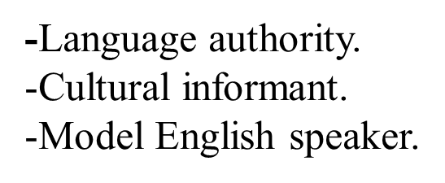
1-Roles related to English language abilities:

Slide 7
2-Roles related to the ability to create meaningful interaction:
-Needs assessor.
-Classroom manager.
-Text adapter.
-Entertainer.

Slide 8
Thank you

